Slide 1
WIA1005 Network Technology Foundation
Chapter 1
Network Communication

Slide 2
Contents
Introduction
Network Components
Network Representations
Types of Networks
Internet Connections
Reliable Network
Network Trends
Network Security

Slide 3
Introduction
The Internet of Everything (IoE) is bringing together people, process, data, and things to make networked connections more relevant and valuable.
The Internet has changed the manner in which our social, commercial, political, and personal interactions occur.
In today’s world, through the use of networks, we are connected like never before. News events and discoveries are known worldwide in seconds.
The creation of the Cloud lets us store documents and pictures and access them anywhere, anytime.

Slide 4
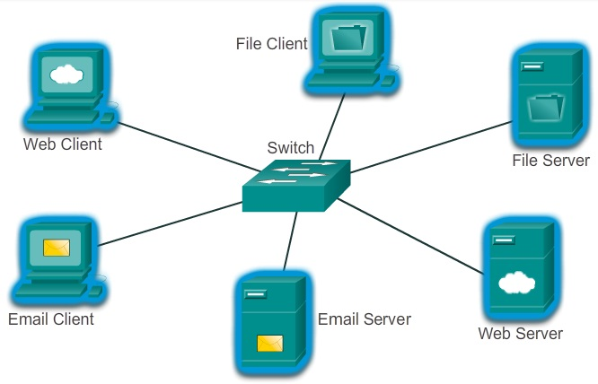
Introduction
All computers connected to a network that participate directly in network communication are classified as hosts or end devices.
Host can send and receive messages on the network.
In modern networks, end devices can act as a Client, a Server, or both.

Slide 5
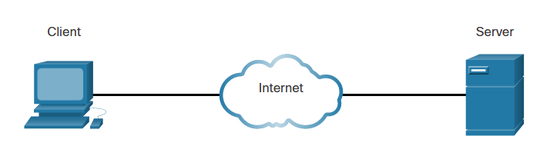
Introduction
Servers are computers with software that allow them to provide information, like email or web pages, to other end devices on the network. Each service requires separate server software.

Slide 6
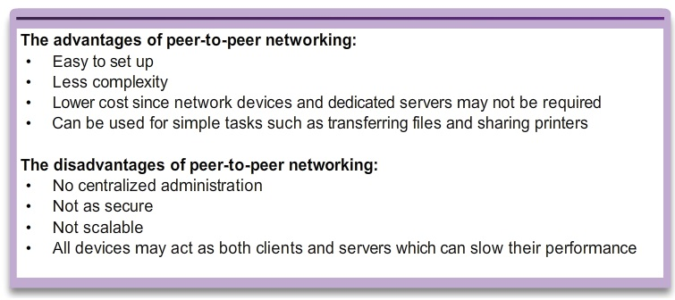
Introduction
In a peer-to-peer network, a host can become client and server at the same time.

Slide 7
Network Components
The network infrastructure contains three categories of network components such as devices, media and services.
Devices and media are the physical elements, or hardware, of the network.
Services include many of the common network applications people use every day, like email hosting services and web hosting services. The service is usually provided by the servers and accessed via a network by clients.

Slide 8
Network Components
End devices
  The network devices that form the interface between users and the underlying communication network.
  Computers (work stations, laptops, file servers, web servers)
  Network printers
  VoIP phones
  Telepresence endpoint
  Security cameras
  Mobile handheld devices (such as smartphones, tablets, PDAs, and wireless debit/credit card readers and barcode scanners)

Slide 9
Network Components
Intermediary devices
  Interconnect end devices. These devices provide connectivity and work behind the scenes to ensure that data flows across the network.
  Intermediary devices connect the individual hosts to the network and can connect multiple individual networks to form an internetwork.
  Network Access (switches and wireless access points)
  Internetworking (routers)
  Security (firewalls)

Slide 10
Network Components
Network Media
  Communication across a network is carried on a medium. The medium provides the channel over which the message travels from source to destination.
  Common media includes:
    Metallic wires within cables
    Glass or plastic fibers (fiber optic cable)
    Wireless transmission

Slide 11
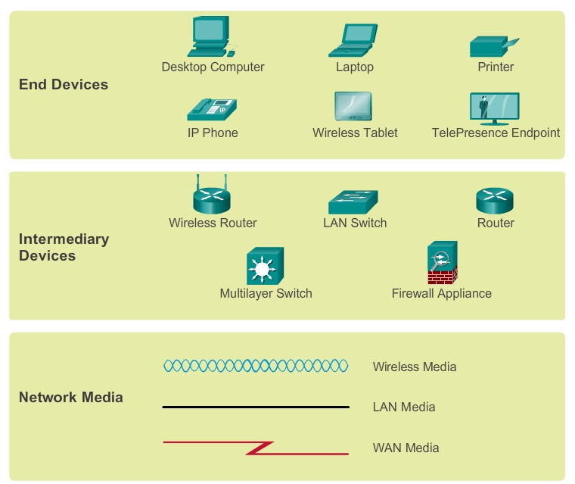
Network Components

Slide 12
Network Representations
A network diagram provides an easy way to understand how devices connect in a large network.
The ability to recognize the logical representations of the physical networking components is critical to being able to visualize the organization and operation of a network.
Topology diagrams provides a visual map of how the network is connected.
There are two types of topology diagrams:
  Physical topology diagrams
    Identify the physical location of intermediary devices, configured ports, and cable installation.
  Logical topology diagrams
    Identify devices, ports, and IP addressing scheme.

Slide 13
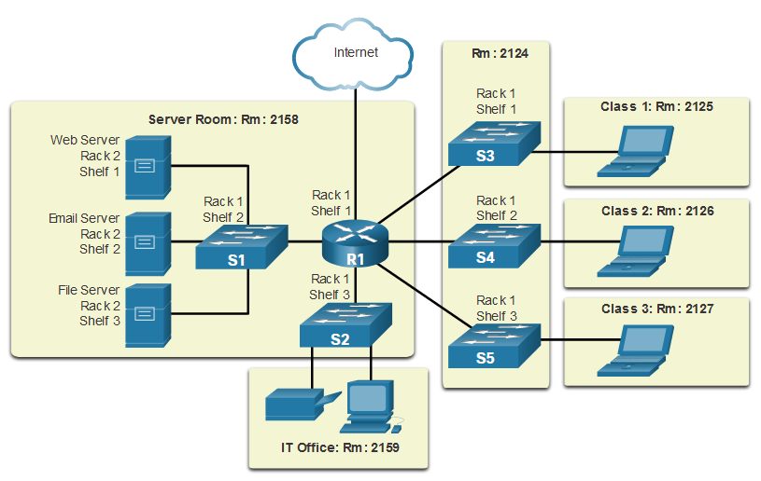
Network Representations
Physical Topology Diagram

Slide 14
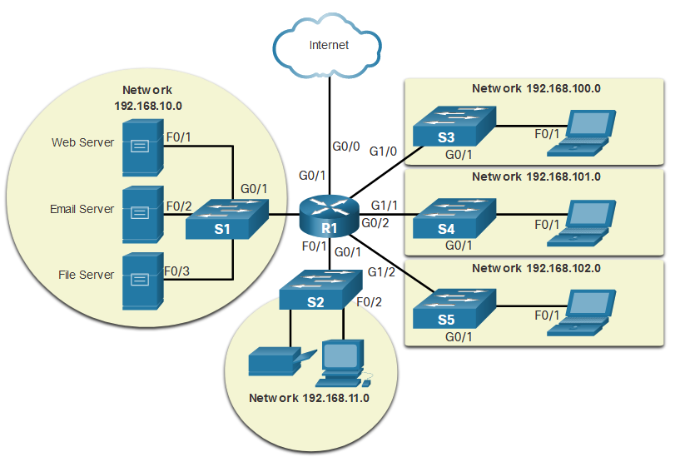
Network Representations
Logical Topology Diagram

Slide 15
Types of Networks
Networks come in all sizes. They can range from simple networks consisting of two computers to networks connecting millions of devices.
Simple home networks let you share resources, such as printers, documents, pictures, and music, among a few local end devices.
Small office and home office (SOHO) networks allow people to work from home, or a remote office. Many self-employed workers use these types of networks to advertise and sell products, order supplies, and communicate with customers.

Slide 16
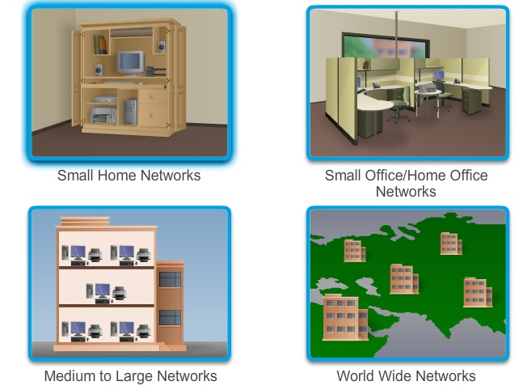
Types of Networks
Medium to large networks, such as those used by corporations and schools, can have many locations with hundreds or thousands of interconnected hosts.
The Internet is a network of networks that connects hundreds of millions of computers world-wide.

Slide 17
Types of Networks
Network infrastructures can vary greatly in terms of:
  Size of the area covered
  Number of users connected
  Number and types of services available
  Area of responsibility
The two most common types of network infrastructures are Local Area Networks (LANs), and Wide Area Networks (WANs).

Slide 18
Types of Networks
Local Area Network (LAN)
  A network infrastructure that provides access to users and end devices in a small geographical area.
  LANs interconnect end devices in a limited area such as a home, school, office building, or campus.
  A LAN is usually administered by a single organization or individual.
  LANs provide high-speed bandwidth to internal end devices and intermediary devices.

Slide 19
Types of Networks
Wide Area Network (WAN)
  A network infrastructure that provides access to other networks over a wide geographical area.
  WANs interconnect LANs over wide geographical areas such as between cities, states, provinces, countries, or continents.
  WANs are usually administered by multiple service providers.
  WANs typically provide slower speed links between LANs.

Slide 20
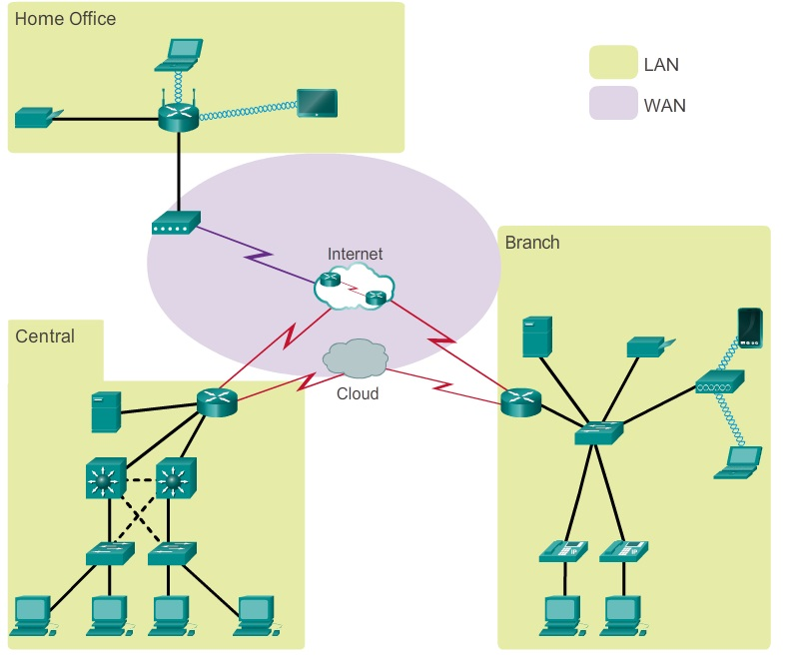
Types of Networks

Slide 21
Types of Networks
Internet is a worldwide collection of interconnected networks cooperating with each other to exchange information using common standards.
Intranet is a term often used to refer to a private connection of LANs and WANs that belongs to an organization, and is designed to be accessible only by the organization's members, employees, or others with authorization.
An organization may use an Extranet to provide secure and safe access to individuals who work for a different organizations, but require access to company data. Extranet allows controlled access to the group of users to a subset of information.

Slide 22
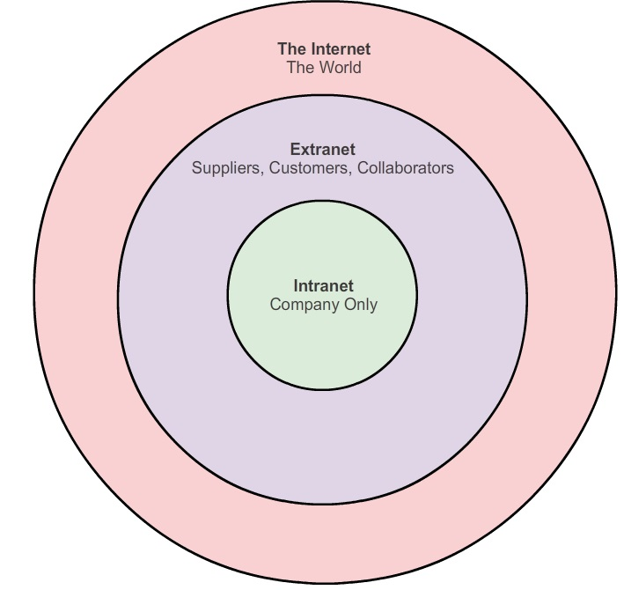
Types of Networks
Some examples of extranets:
  A company that is providing access to outside suppliers and contractors
  A hospital that is providing a booking system to doctors so they can make appointments for their patients

Slide 23
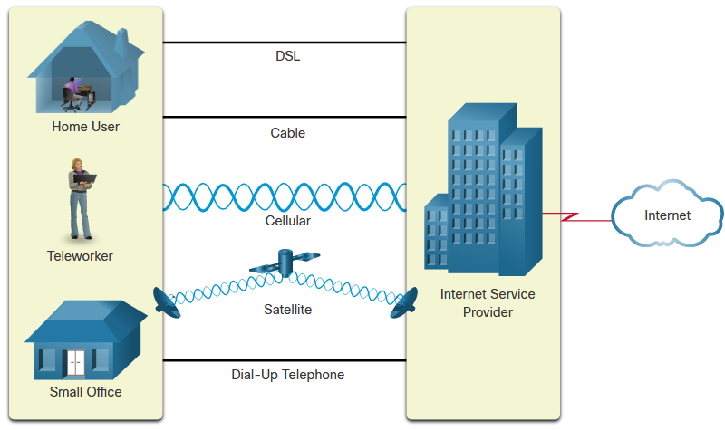
Internet Connections
Home users, remote workers, and small offices typically require a connection to an ISP to access the internet.
Connection options vary greatly between ISPs and geographical locations. However, popular choices include broadband cable, broadband digital subscriber line (DSL), wireless WANs, and mobile services.

Slide 24
Internet Connections
Cable - Typically offered by cable television service providers, the internet data signal transmits on the same cable that delivers cable television. It provides a high bandwidth, high availability, and an always-on connection to the internet.
DSL - Digital Subscriber Lines also provide high bandwidth, high availability, and an always-on connection to the internet. DSL runs over a telephone line. In general, small office and home office users connect using Asymmetrical DSL (ADSL), which means that the download speed is faster than the upload speed.
Cellular - Cellular internet access uses a cell phone network to connect. (3G, 4G, 5G)

Slide 25
Internet Connections
Satellite - The availability of satellite internet access is a benefit in those areas that would otherwise have no internet connectivity at all. Satellite dishes require a clear line of sight to the satellite.
Dial-up Telephone - An inexpensive option that uses any phone line and a modem. The low bandwidth provided by a dial-up modem connection is not sufficient for large data transfer, although it is useful for mobile access while traveling.

Slide 26
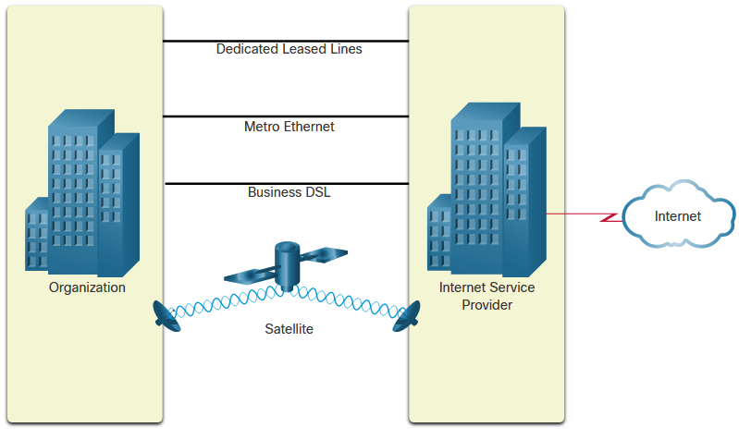
Internet Connections
Businesses may require higher bandwidth, dedicated bandwidth, and managed services.

Slide 27
Internet Connections
Dedicated Leased Line - Leased lines are reserved circuits within the service provider’s network that connect geographically separated offices for private voice and/or data networking. The circuits are rented at a monthly or yearly rate.
Metro Ethernet - Metro Ethernets extend LAN access technology into the WAN.
Business DSL - Business DSL is available in various formats. A popular choice is Symmetric Digital Subscriber Line (SDSL) which is similar to the consumer version of DSL but provides uploads and downloads at the same high speeds.

Slide 28
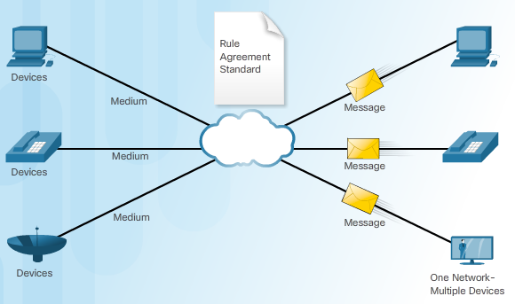
Internet Connections
Networks must support a wide range of applications and services, as well as operate over many different types of cables and devices. Converged data networks carry multiple services on one network.

Slide 29
Reliable Network
Network architecture refers to the technologies that support the infrastructure and the programmed services and rules, or protocols, that move data across the network.
There are four basic characteristics that the network architectures need to address in order to meet user expectations:
  Fault Tolerance
  Scalability
  Quality of Service (QoS)
  Security

Slide 30
Reliable Network
Fault Tolerance
  A fault tolerant network is one that limits the impact of a failure, so that the fewest number of devices are affected by it.
  It is also built in a way that allows quick recovery when such a failure occurs.
  These networks depend on multiple paths between the source and destination of a message. If one path fails, the messages are instantly sent over a different link. Having multiple paths to a destination is known as redundancy.

Slide 31
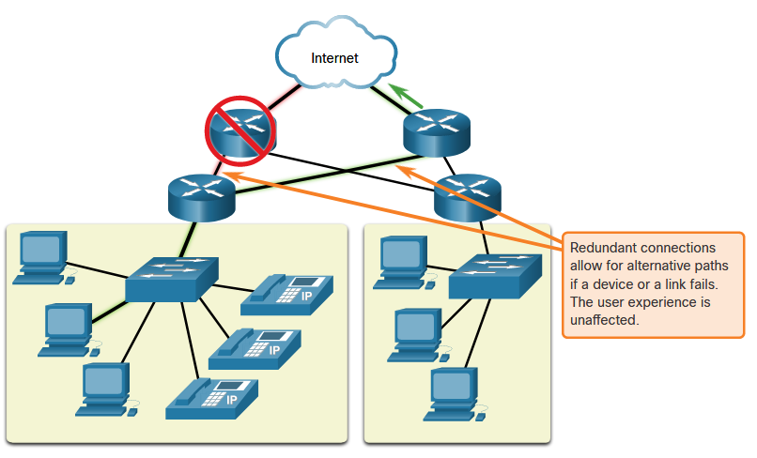
Reliable Network

Slide 32
Reliable Network
Scalability
  A scalable network can expand quickly to support new users and applications without degrading the performance of services that are being accessed by existing users.
  Scalability also refers to the ability to accept new services and applications. These networks are scalable because the designers follow accepted standards and protocols.

Slide 33
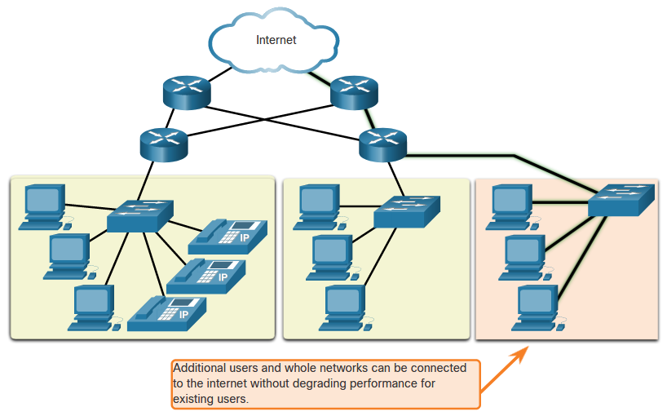
Reliable Network

Slide 34
Reliable Network
Quality of Service
  As data, voice, and video content continue to converge onto the same network, QoS becomes a primary mechanism for managing congestion and ensuring reliable delivery of content to all users.
  When simultaneous communications are attempted across the network, the demand for network bandwidth can exceed its availability, creating network congestion.
  With a QoS policy in place, the router can manage the flow of data and voice traffic, giving priority to voice communications if the network experiences congestion.

Slide 35
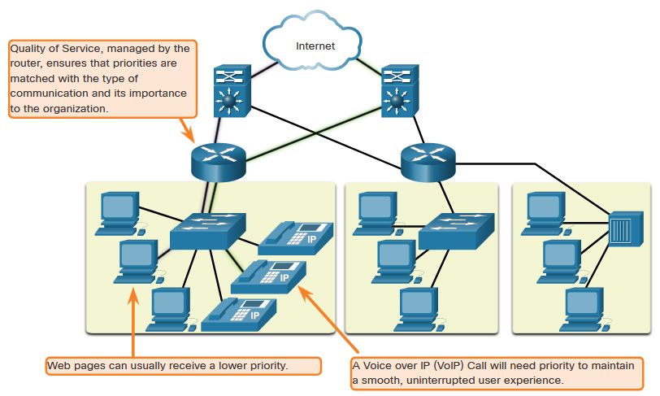
Reliable Network

Slide 36
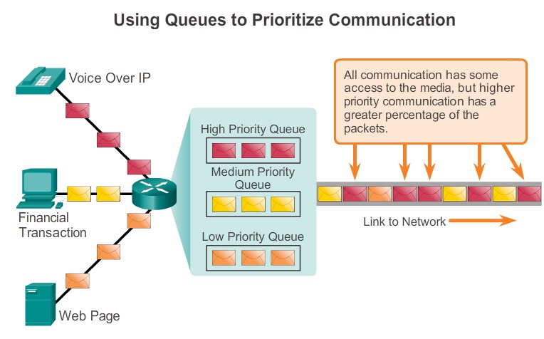
Reliable Network

Slide 37
Reliable Network
Network Security
  The network infrastructure, services, and the data contained on network attached devices are crucial personal and business assets. Compromising the integrity of these assets could have serious consequences
  Securing a network infrastructure includes the physical securing of devices that provide network connectivity, and preventing unauthorized access to the management software that resides on them.
  Information security refers to protecting the information contained within the packets being transmitted over the network and the information stored on network attached devices.

Slide 38
Reliable Network
Three primary network security requirements:
Ensuring confidentiality
  Data confidentiality means that only the intended and authorized recipients - individuals, processes, or devices – can access and read data.
Maintaining communication integrity
  Data integrity means having the assurance that the information has not been altered in transmission, from origin to destination.
Ensuring availability
  Availability means having the assurance of timely and reliable access to data services for authorized users.

Slide 39
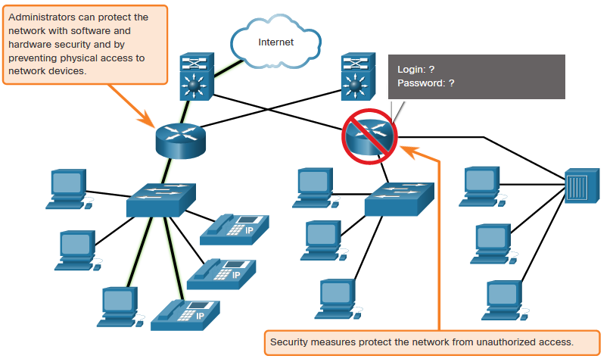
Reliable Network

Slide 40
Network Trends
Bring Your Own Device (BYOD)
  Any device, with any ownership, used anywhere.
  Enables end users to use personal tools to access information and communicate across a business or campus network.
Online Collaboration
  the act of working with another or others on a joint project.
  Cisco Webex Teams is a multifunctional collaboration tool that lets you send instant messages to one or more people, post images, and post videos and links.

Slide 41
Network Trends
Video communications
  Video conferencing is a powerful tool for communicating with others, both locally and globally.
Cloud computing
  One of the ways that we access and store data.
  Allows us to store personal files and backup data on servers over the internet.
  Applications such as word processing and photo editing can be accessed using the cloud.
  There are four primary types of clouds: Public clouds, Private clouds, Hybrid clouds, and Community clouds.

Slide 42
Network Trends
Smart Home
  Smart home technology integrates into every-day appliances, which can then connect with other devices to make the appliances more ‘smart’ or automated.
Powerline Networking
  Powerline networking for home networks uses existing electrical wiring to connect device.
  Using a standard powerline adapter, devices can connect to the LAN wherever there is an electrical outlet. No data cables need to be installed, and there is little to no additional electricity used.

Slide 43
Network Security
Network security is an integral part of computer networking. Securing a network involves protocols, technologies, devices, tools, and techniques in order to protect data and mitigate threats.
There are several common external threats to networks:
  Viruses, worms, and Trojan horses - Malicious software or code running on a user device.
  Spyware and adware - Types of software which are installed on a user’s device. The software then secretly collects information about the user.
  Zero-day attacks - Occur on the first day that a vulnerability becomes known.

Slide 44
Network Security
  Threat actor attacks - A malicious person attacks user devices or network resources.
  Denial of service attacks - These attacks slow or crash applications and processes on a network device.
  Data interception and theft - This attack captures private information from an organization’s network.
  Identity theft - This attack steals the login credentials of a user in order to access private data.

Slide 45
Network Security
Basic security components for a home or small office network:
  Antivirus and antispyware - These applications help to protect end devices from becoming infected with malicious software.
  Firewall filtering - Block unauthorized access into and out of the network.
Extra security requirements for larger networks and corporate networks:
  Dedicated firewall systems - Filter large amounts of traffic with more granularity.
  Access control lists (ACL) - Filter access and traffic forwarding based on IP addresses and applications.

Slide 46
Network Security
  Intrusion prevention systems (IPS) - These identify fast-spreading threats, such as zero-day or zero-hour attacks.
  Virtual private networks (VPN) - These provide secure access into an organization for remote workers.

